Slide 1

Machine Learning
ICT-4261
By-
Dr. Jesmin Akhter
Professor
Institute of Information Technology
Jahangirnagar University

Slide 2
Contents
The course will mainly cover the following topics:
A Gentle Introduction to Machine Learning
Important Elements in Machine Learning
Linear Regression
Logistic Regression
Naive Bayes
Support Vector Machines
Decision Trees and Ensemble Learning
Clustering Fundamentals
Hierarchical Clustering
Neural Networks and Deep Learning
Unsupervised Learning

Slide 3
Outline
Support Vector Machines

Slide 4
Support Vector Machines
Support Vector Machine (SVM) is a powerful machine learning algorithm used for linear or nonlinear classification, regression, and even outlier detection tasks.
SVMs can be used for a variety of tasks, such as text classification, image classification, spam detection, handwriting identification, gene expression analysis, face detection, and anomaly detection. SVMs are adaptable and efficient in a variety of applications because they can manage high-dimensional data and nonlinear relationships.
SVM algorithms are very effective as we try to find the maximum separating hyperplane between the different classes available in the target feature.
Sometimes a dataset can contain extreme values that are outside the range of what is expected and unlike the other data. These are called outliers and often machine learning modeling and model skill in general can be improved by understanding and even removing these outlier values.
Notes:
An outlier is a data point that significantly deviates from the rest of the data. It can be either much higher or much lower than the other data points, and its presence can have a significant impact on the results of machine learning algorithms.
Similarly, an Outlier is an observation in a given dataset that lies far from the rest of the observations. That means an outlier is vastly larger or smaller than the remaining values in the set.

Slide 5
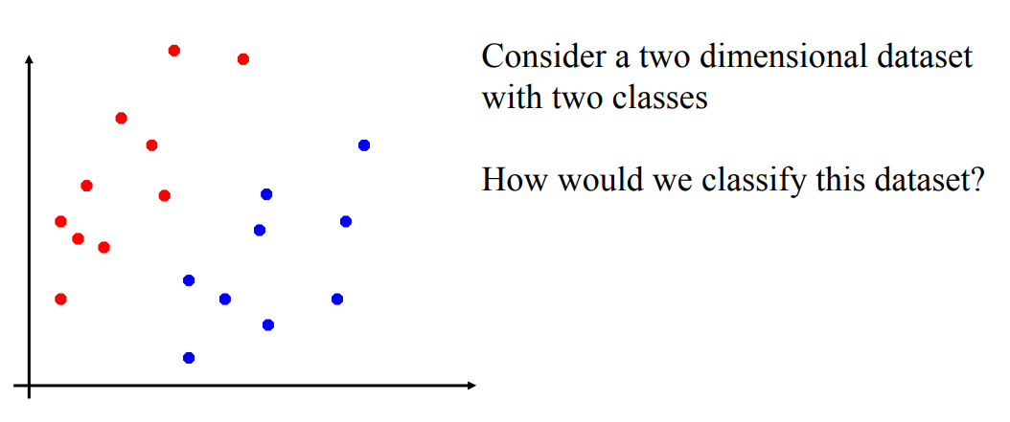
Linear Classifiers

Slide 6
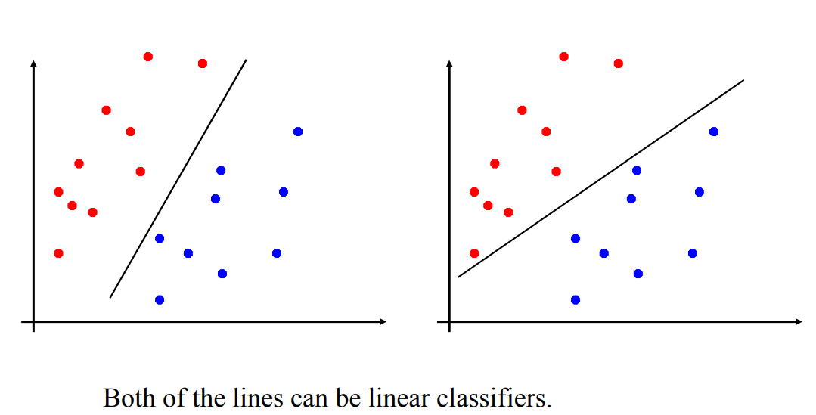
Linear Classifiers

Slide 7
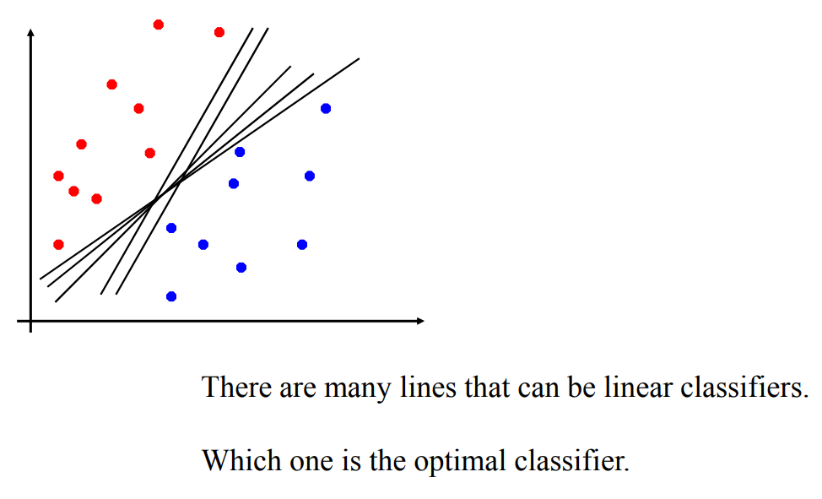
Linear Classifiers

Slide 8
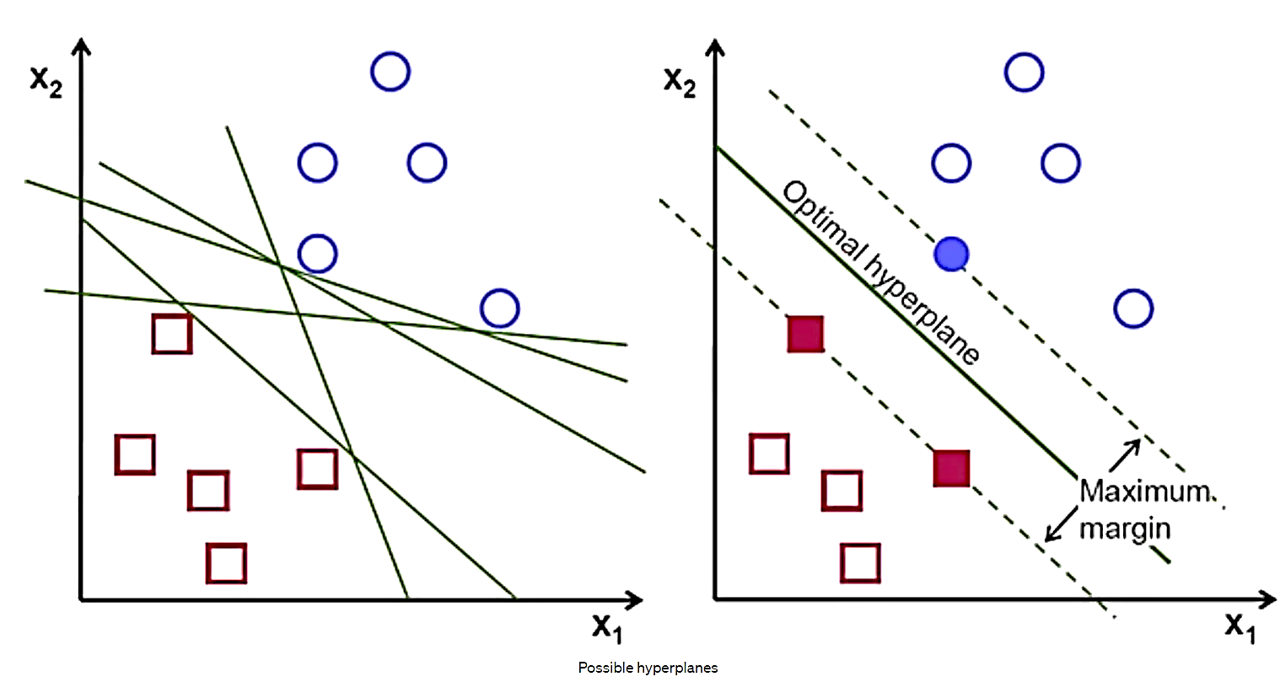
Objective-Support Vector Machines
The main objective of the SVM algorithm is to find the optimal hyperplane in an N-dimensional space that can separate the data points in different classes in the feature space.
The hyperplane tries that the margin between the closest points of different classes should be as maximum as possible.

Slide 9
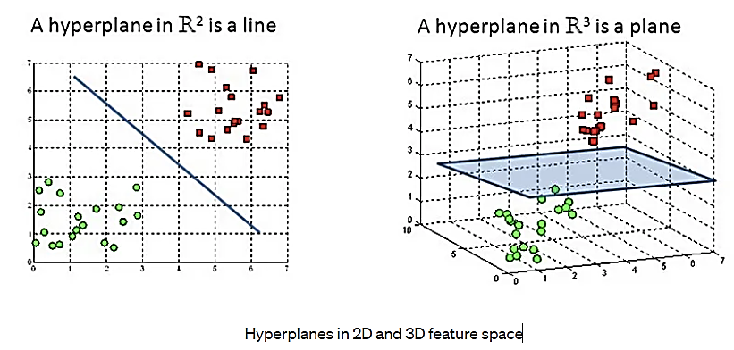
Hyperplanes and Support Vectors
Hyperplanes are decision boundaries that help classify the data points. Data points falling on either side of the hyperplane can be attributed to different classes. Also, the dimension of the hyperplane depends upon the number of features. If the number of input features is 2, then the hyperplane is just a line. If the number of input features is 3, then the hyperplane becomes a two-dimensional plane. It becomes difficult to imagine when the number of features exceeds 3.

Slide 10
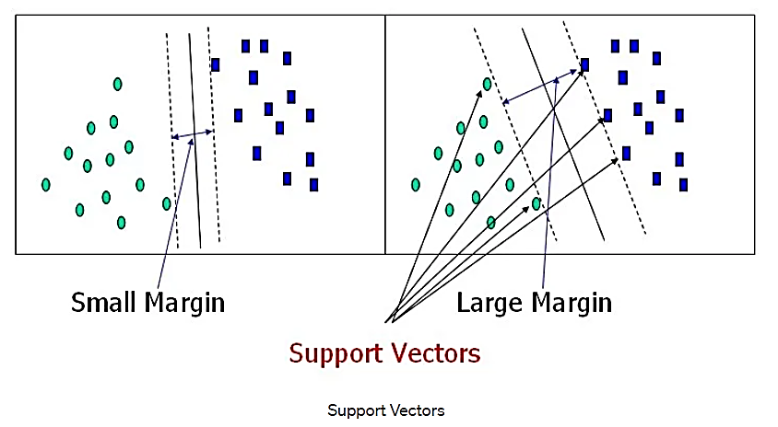
Hyperplanes and Support Vectors
Support vectors are data points that are closer to the hyperplane and influence the position and orientation of the hyperplane. Using these support vectors, we maximize the margin of the classifier. Deleting the support vectors will change the position of the hyperplane. These are the points that help us build our SVM.

Slide 11
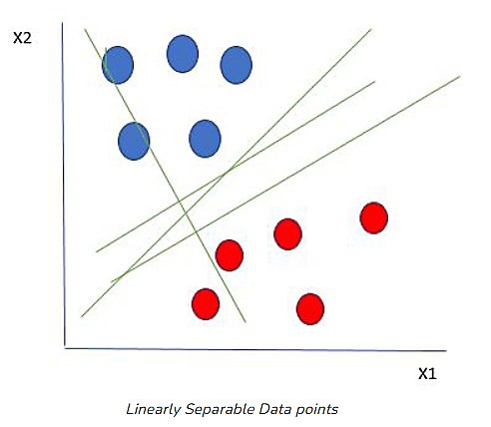
Hyperplanes and Support Vectors
Let’s consider two independent variables x₁, x_{2,} and one dependent variable which is either a blue circle or a red circle.
From the figure above it’s very clear that there are multiple lines (our hyperplane here is a line because we are considering only two input features x₁, x₂) that segregate our data points or do a classification between red and blue circles. So how do we choose the best line or in general the best hyperplane that segregates our data points?

Slide 12
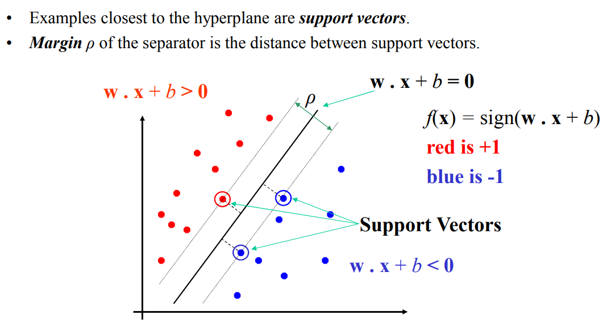
Hyperplanes and Support Vectors
A separating line will be defined with the help of Support Vectors.

Slide 13
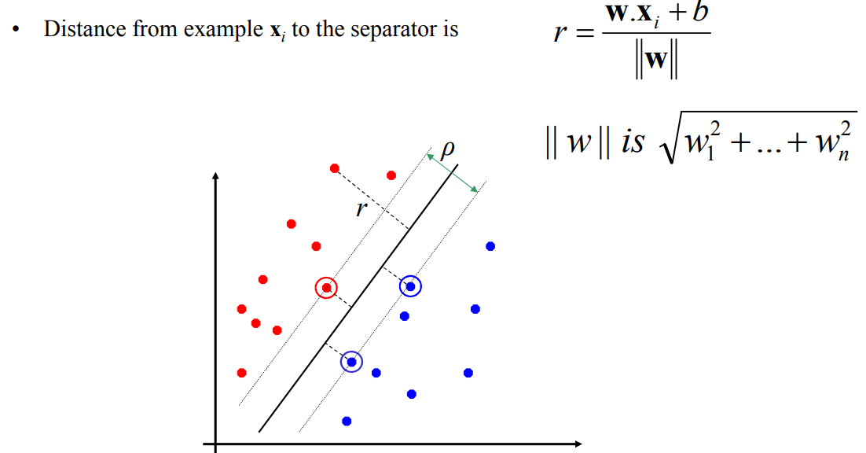
Hyperplanes and Support Vectors
d = |Ax₁ + By₁ + C|]/ √(A² + B²)

Slide 14
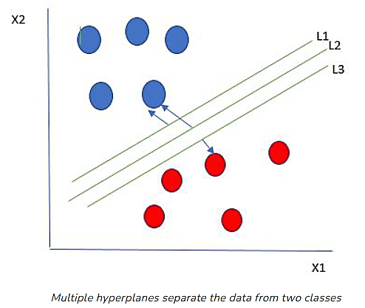
How does SVM work?
One reasonable choice as the best hyperplane is the one that represents the largest separation or margin between the two classes.
So we choose the hyperplane whose distance from it to the nearest data point on each side is maximized. If such a hyperplane exists it is known as the maximum-margin hyperplane/hard margin. So from the above figure, we choose L2

Slide 15
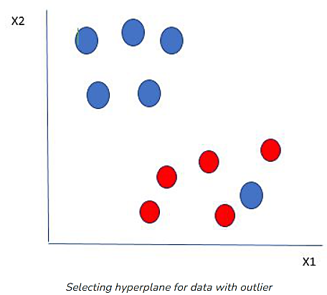
How does SVM work?
Let’s consider a scenario like shown below
Here we have one blue ball in the boundary of the red ball. So how does SVM classify the data? It’s simple! The blue ball in the boundary of red ones is an outlier of blue balls. The SVM algorithm has the characteristics to ignore the outlier and finds the best hyperplane that maximizes the margin. SVM is robust to outliers.
Notes:
an outlier is a data point that differs greatly from other values in a data set.
a person or thing situated away or detached from the main body or system.

Slide 16
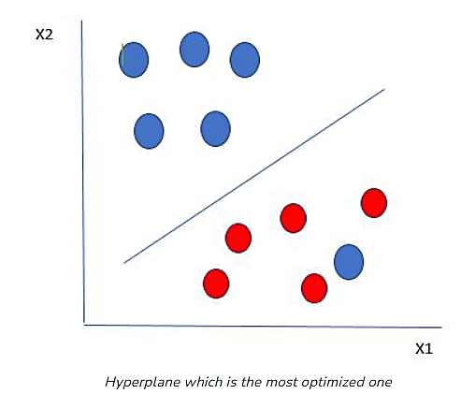
How does SVM work?
So in this type of data point what SVM does is, finds the maximum margin as done with previous data sets along with that it adds a penalty each time a point crosses the margin. So the margins in these types of cases are called soft margins.

Slide 17
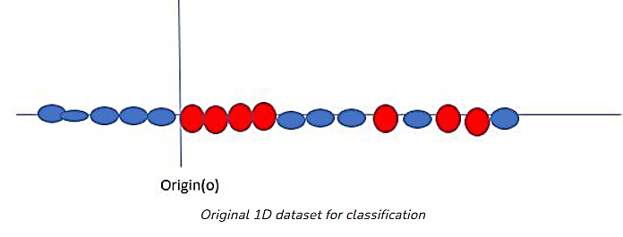
How does SVM work?
Till now, we were talking about linearly separable data(the group of blue balls and red balls are separable by a straight line/linear line). What to do if data are not linearly separable?
Say, our data is shown in the figure above. SVM solves this by creating a new variable using a kernel.

Slide 18
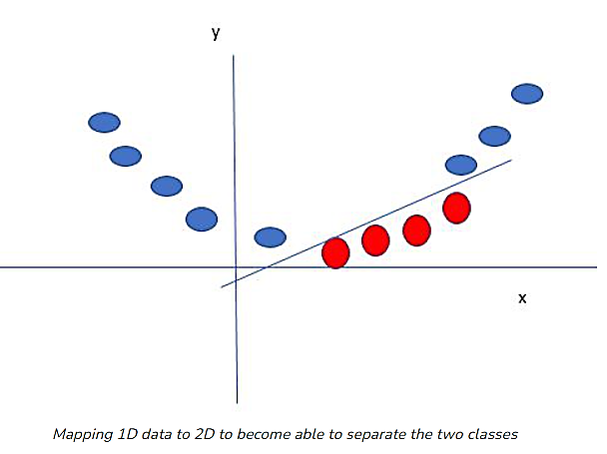
How does SVM work?
We call a point x_{i} on the line and we create a new variable y_{i} as a function of distance from origin o. So if we plot this we get something like as shown below
In this case, the new variable y is created as a function of distance from the origin. A non-linear function that creates a new variable is referred to as a kernel.

Slide 19
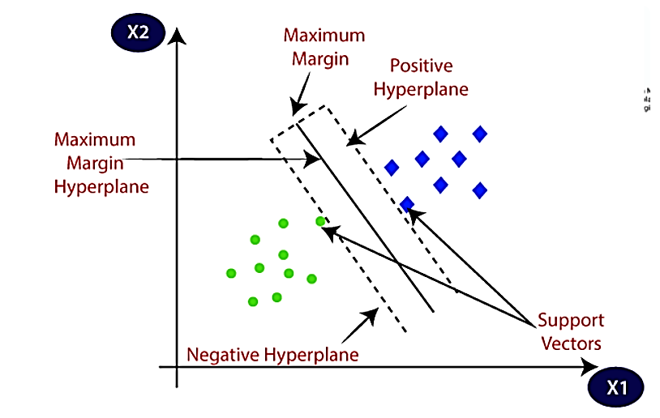
Margin
Margin: it is the distance between the hyperplane and the observations closest to the hyperplane (support vectors). In SVM large margin is considered a good margin. There are two types of margins hard margin and soft margin.

Slide 20
The Role of Margin in SVMs
Let’s start with a set of data points that we want to classify into two groups. We can consider two cases for these data: either they are linearly separable, or the separating hyperplane is non-linear.
When the data is linearly separable, and we don’t want to have any misclassifications, we use SVM with a hard margin. However, when a linear boundary is not feasible, or we want to allow some misclassifications in the hope of achieving better generality, we can opt for a soft margin for our classifier.

Slide 21
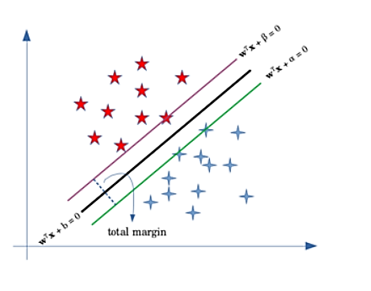
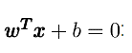
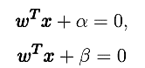
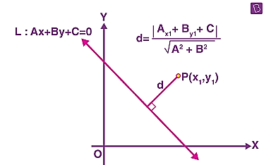
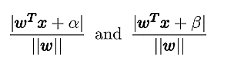
SVM with a Hard Margin
assume that the hyperplane separating our two classes is defined as
Then, we can define the margin by two parallel hyperplanes:
They are the green and purple lines in the above figure. Without allowing any misclassifications in the hard margin SVM, we want to maximize the distance between the two hyperplanes.
To find this distance, we can use the formula for the distance of a point from a plane. So the distance of the blue points and the red point from the black line would respectively be:
Notes:
Find the distance of the point (-3, 5) from the line 4x – 3y – 26 = 0.
Solution:
Given equation of a line is: 4x – 3y – 26 = 0
Point: (-3, 5)
Comparing these with the standard forms,
A = 4, B = -3, C = -26
x₁ = -3, y₁ = 5
We know that the perpendicular distance (d) of a line Ax + By+ C = 0 from a point (x₁, y₁) is given by
d = |Ax₁ + By₁ + C|]/ √(A² + B²)
Substituting the values,
d = |4(-3) + (-3)(5) + (-26)|/√[(4)² + (-3)²]
= |-12 – 15 – 26|/√(16 + 9)
= |-53|/√25
= 53/5

Slide 22
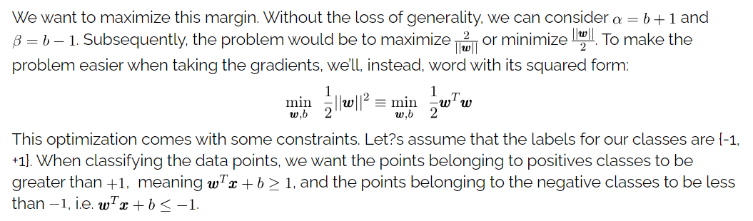
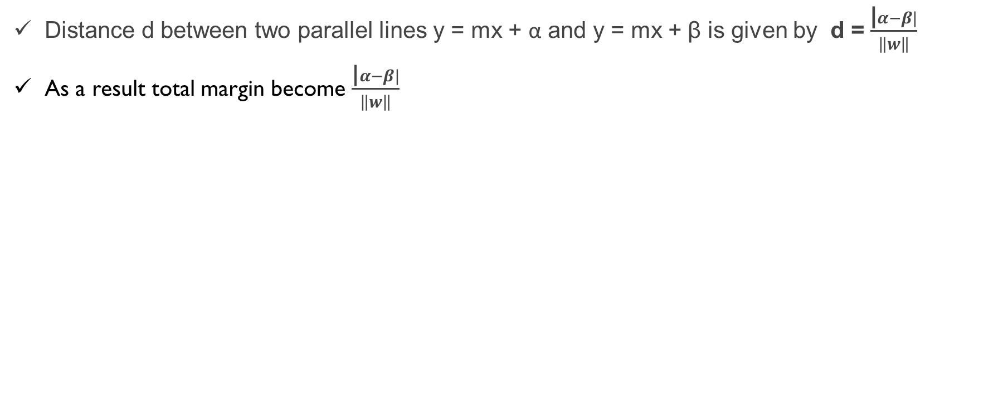
SVM with a Hard Margin
Distance d between two parallel lines y = mx + α and y = mx + β is given by d = $\frac{\text{|}α−β|}{\left\|w\right\|}$
As a result total margin become $\frac{\text{|}α−β|}{\left\|w\right\|}$
Notes:
https://www.baeldung.com/cs/svm-hard-margin-vs-soft-margin#:~:text=When%20the%20data%20is%20linearly,soft%20margin%20for%20our%20classifier.

Slide 23
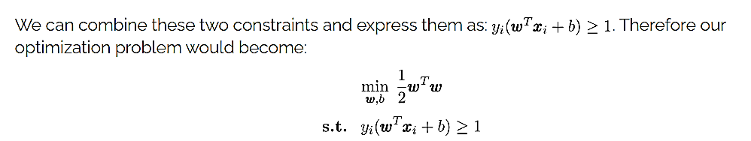
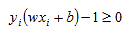
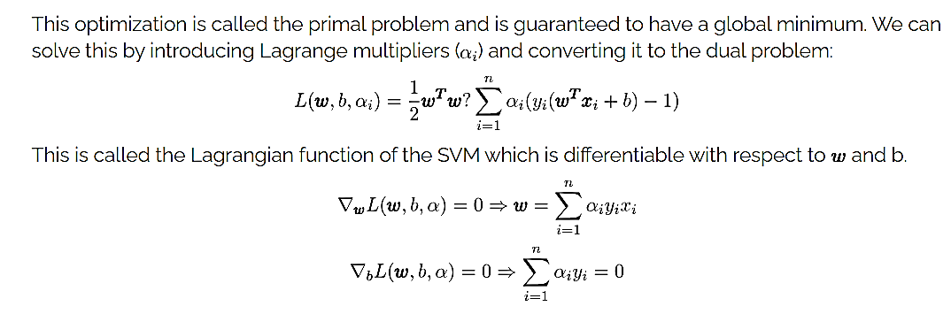
SVM with a Hard Margin
For this we multiply all of the constraints by Lagrange multipliers (alphas) and subtract from our objective function:
-
Notes:
https://asmquantmacro.com/2016/06/14/support-vector-machines-without-tears-part-1/

Slide 24
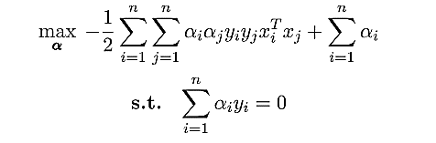
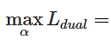
SVM with a Hard Margin
By substituting them in the second term of the Lagrangian function, we will get the dual problem of SVM:
The dual problem is easier to solve since it has only the Lagrange multipliers. Also, the fact that the dual problem depends on the inner products of the training data which is convenient when extending linear SVM to learn non-linear boundaries.

Slide 25
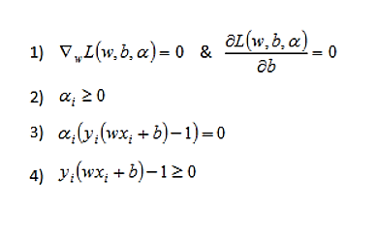
SVM with a Hard Margin
the quadratic optimization problem is a well studied problem. A quadratic objective function with linear inequality constraints must satisfy some conditions at the solution. These conditions are known as KKT conditions and are named after Karush, Kuhn and Tucker who independently derived them.
The KKT conditions are:

Slide 26
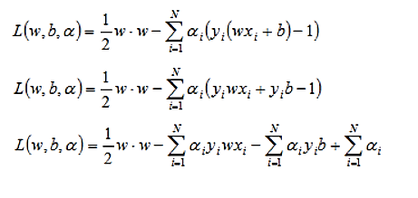
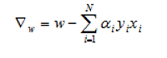
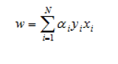
SVM with a Hard Margin
First lets expand the Lagrangian to isolate the w and b terms:
Now we can take the derivative of our Lagrange function with respect to the vector w to get:
And by setting the result equal to zero and solving for w we get:

Slide 27
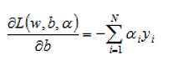
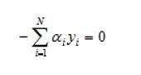
SVM with a Hard Margin
Now we can move on to the derivative of the Lagrange formula with respect to b. We have:
And we again set the result equal to zero:

Slide 28
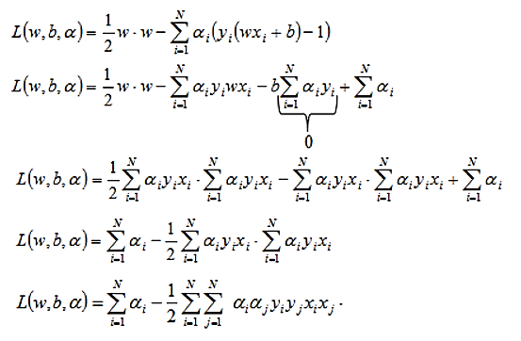
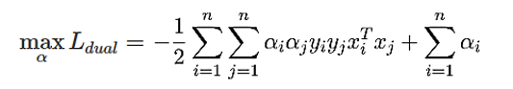
SVM with a Hard Margin
Now let’s substitute these results into the Lagrange function:

Slide 29
SVM with a Hard Margin
It is important to note that we are now trying to maximize this Lagrange function since it is only a function of alphas. This is the so-called Dual formulation of the optimization problem.

Slide 30
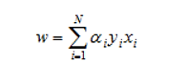
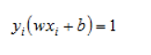
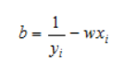
SVM with a Hard Margin
Once we solve for alphas we need to be able to use our classifier. That means we need the coefficients of our hyperplane. To get back our coefficients w we can use below equation that we derived earlier:
Once we have our w we can use the fact that for any of the support vectors we have:
And we can solve this for our b coefficient:

Slide 31
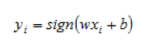
SVM with a Hard Margin
Now that we have our hyperplane coefficients we can use our classifier to assign any observation xi by plugging it into below equation:

Slide 32
SVM with a Hard Margin
In a hard margin SVM, the goal is to find the hyperplane that can perfectly separate the data into two classes without any misclassification. However, this is not always possible when the data is not linearly separable or contains outliers. In such cases, the hard margin SVM will fail to find a hyperplane that can perfectly separate the data, and the optimization problem will have no solution.

Slide 33
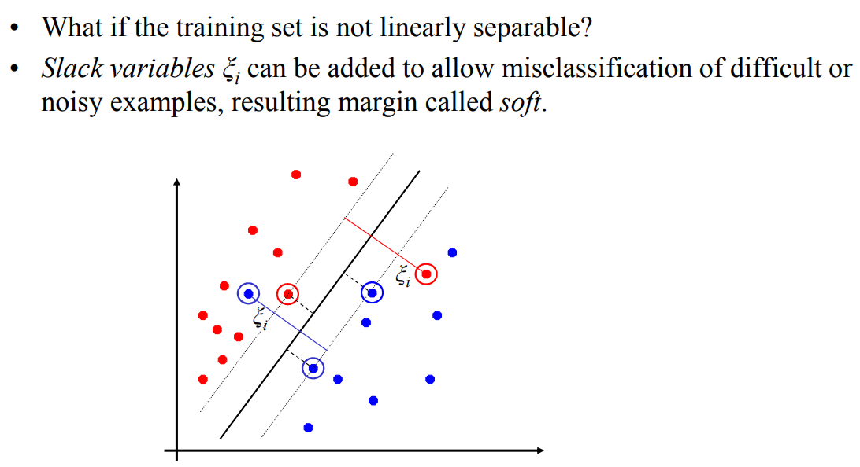
Soft Margin Classification

Slide 34
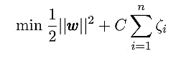
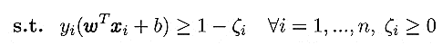
SVM with a Soft Margin
The soft margin SVM follows a somewhat similar optimization procedure with a couple of differences.
First, in this scenario, we allow misclassifications to happen. So we’ll need to minimize the misclassification error, which means that we’ll have to deal with one more constraint.
Second, to minimize the error, we should define a loss function. A common loss function used for soft margin is the hinge loss.
The loss of a misclassified point is called a slack variable and is added to the primal problem that we had for hard margin SVM. So the primal problem for the soft margin becomes
The parameter C controls the relative weighting between the goal of making the margin small and ensuring that most examples have functional margins that are at least 1. We would therefore like to minimize the sum total of the penalties ξi over all i (this is an upper bound on the training classification errors).

Slide 35
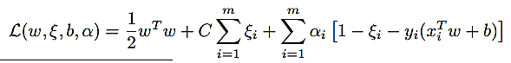
SVM with a Soft Margin
The introduction of the slack variables allows us to create a flexible margin so that some vectors belonging to a class can also be found in the opposite part of the hyperspace and can be included in the model training.
The strength of this flexibility can be set using the parameter C.
Small values (close to zero) bring about very hard margins, while values greater than or equal to 1 allow more and more flexibility (also increasing the misclassification rate).
Ideally, we are interested in the number of non zero ξi , as that is the count of errors made by our classifier on the set of training examples.
We take the lagrangian in the usual manner:
Notes:
https://dm.cs.tu-dortmund.de/en/mlbits/class-svm-kernel-trick/

Slide 36
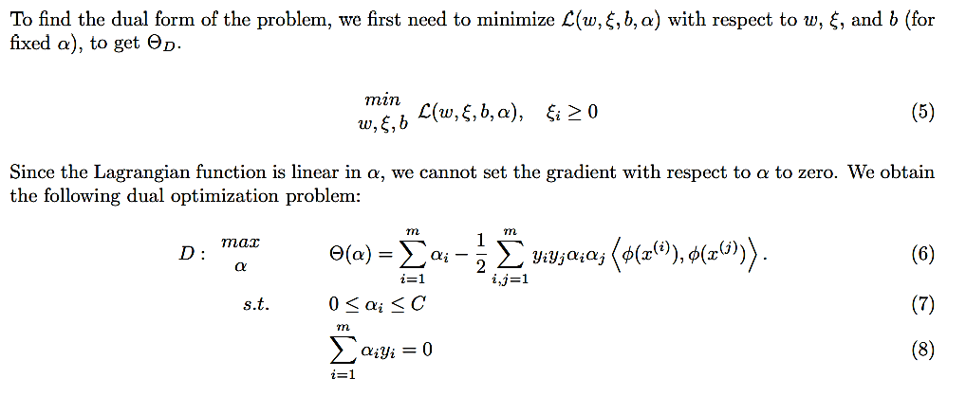
SVM with a Soft Margin
Notes:
https://www.adeveloperdiary.com/data-science/machine-learning/support-vector-machines-for-beginners-duality-problem/#duality-soft-margin-classifier

Slide 37
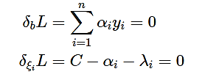
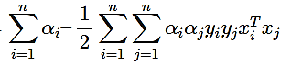
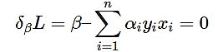
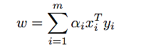
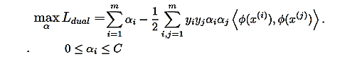
SVM with a Soft Margin
W
ki
Plugging these to the Lagrangian we get,
We obtain the following dual optimization problem:
W
W
Notes:
https://www.adeveloperdiary.com/data-science/machine-learning/support-vector-machines-for-beginners-duality-problem/

Slide 38
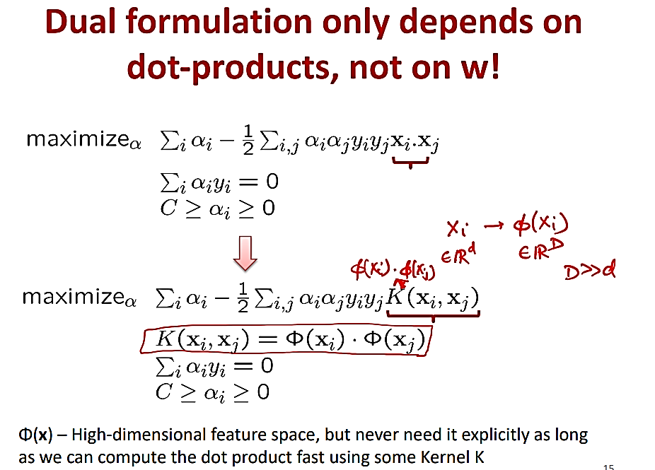
SVM with a Soft Margin

Slide 39


Slide 40


Slide 41
Hard Margin vs. Soft Margin
The difference between a hard margin and a soft margin in SVMs lies in the separability of the data. If our data is linearly separable, we go for a hard margin. However, if this is not the case, it won’t be feasible to do that. In the presence of the data points that make it impossible to find a linear classifier, we would have to be more lenient and let some of the data points be misclassified. In this case, a soft margin SVM is appropriate.
Sometimes, the data is linearly separable, but the margin is so small that the model becomes prone to overfitting or being too sensitive to outliers. Also, in this case, we can opt for a larger margin by using soft margin SVM in order to help the model generalize better.

Slide 42
Hard Margin vs. Soft Margin
Geometrically, the soft margin SVM introduces a penalty for the data points that lie on the wrong side of the margin or even on the wrong side of the hyperplane. The slack variables ξi allow these data points to be within the margin or on the wrong side of the hyperplane, but they incur a penalty in the objective function. The optimization problem in a soft margin SVM finds the hyperplane that maximizes the margin while minimizing the penalty for the misclassified data points.
hard margin SVM aims to find a hyperplane that perfectly separates the data into two classes without any misclassification, while soft margin SVM allows some misclassification by introducing slack variables. Geometrically, the hard margin SVM looks for the widest margin possible, while the soft margin SVM finds the hyperplane that maximizes the margin while minimizing the penalty for misclassification.

Slide 43
Types of Support Vector Machine
Based on the nature of the decision boundary, Support Vector Machines (SVM) can be divided into two main parts:
Linear SVM
Non-Linear SVM

Slide 44
Linear SVM
Linear SVMs use a linear decision boundary to separate the data points of different classes. When the data can be precisely linearly separated, linear SVMs are very suitable. This means that a single straight line (in 2D) or a hyperplane (in higher dimensions) can entirely divide the data points into their respective classes. A hyperplane that maximizes the margin between the classes is the decision boundary.
Perfectly linearly separable means that the data points can be classified into 2 classes by using a single straight line(if 2D).

Slide 45

SVM - Linearly Separable

Slide 46
Non-Linear SVM
Non-Linear SVM can be used to classify data when it cannot be separated into two classes by a straight line (in the case of 2D). By using kernel functions, nonlinear SVMs can handle nonlinearly separable data. The original input data is transformed by these kernel functions into a higher-dimensional feature space, where the data points can be linearly separated. A linear SVM is used to locate a nonlinear decision boundary in this modified space.
The kernel function computes the similarity between data points, allowing SVM to capture complex patterns and nonlinear relationships between features. This enables nonlinear SVM to handle intricate data distributions, such as curved or circular decision boundaries. By leveraging the kernel trick, nonlinear SVM provides a powerful tool for solving classification problems where linear separation is insufficient, extending its applicability to a wide range of real-world scenarios.

Slide 47

Non-linear SVMs

Slide 48

Non-linear SVMs: Feature spaces

Slide 49

Non-Linear SVM
Select any kernel function like RBF(gaussian), polynomial, sigmoid and etc instead of a linear and 1-degree model. Kernel function takes as its inputs vectors in the original space and returns the dot product of the vectors in the feature space and this is called kernel function.
Non-linear transformation is to make a dataset higher-dimensional space (Mapping a higher dimension). And it is also the fundamental of a non-linear system. The below graph reveals a non-linear dataset and how it can not be used Linear kernel rather than the Gaussian kernel.

Slide 50

Non-Linear SVM
In geometry, a hyperplane is a subspace whose dimension is one less than that of its ambient space. If space is 3-dimensional then its hyperplanes are the 2-dimensional planes, while if space is 2-dimensional, its hyperplanes are the 1-dimensional lines. This notion can be used in any general space in which the concept of the dimension of a subspace is defined.

Slide 51

Non-Linear SVM: The “Kernel Trick”

Slide 52

Non-Linear SVM: Examples of Kernel Functions

Slide 53

Non-Linear SVM
Kernel Functions
Kernel functions are used to map the input data into a higher-dimensional feature space where the data becomes linearly separable. There are different types of kernel functions available, including linear, polynomial, radial basis function (RBF), and sigmoid. The choice of kernel function depends on the characteristics of the data and the problem being solved.
3.1 Linear Kernel
The linear kernel is used for linearly separable data. It simply computes the dot product between two input vectors. The equation for the linear kernel is:
where x and y are the input vectors.

Slide 54



Non-Linear SVM
3.2 Polynomial Kernel
The polynomial kernel is used for data that is not linearly separable but can be separated using a polynomial function. The equation for the polynomial kernel is:
where d is the degree of the polynomial.
Here d is the degree of the polynomial, which we need to specify manually.
Suppose we have two features X1 and X2 and output variable as Y, so using polynomial kernel we can write it as:

Slide 55


3.3 Radial Basis Function (RBF) Kernel
The RBF kernel is used for data that is not linearly separable in any dimension. The RBF kernel transforms the data into an infinite-dimensional feature space. The equation for the RBF kernel is:

Slide 56

3.4 Sigmoid Kernel
The sigmoid kernel is used for data that is not linearly separable, but it has a sigmoid-shaped decision boundary. We can use it as the proxy for neural networks. The equation for the sigmoid kernel is:
where α is a scaling factor, x is a constant, and tanh is the hyperbolic tangent function.
It is just taking your input, mapping them to a value of 0 and 1 so that they can be separated by a simple straight line.

Slide 57

Popular kernel functions in SVM
The SVM kernel is a function that takes low-dimensional input space and transforms it into higher-dimensional space, ie it converts nonseparable problems to separable problems. It is mostly useful in non-linear separation problems. Simply put the kernel, does some extremely complex data transformations and then finds out the process to separate the data based on the labels or outputs defined.

Slide 58
Support Vector Machine Terminology
Support Vector Machine Terminology
Hyperplane: Hyperplane is the decision boundary that is used to separate the data points of different classes in a feature space. In the case of linear classifications, it will be a linear equation i.e. wx+b = 0.
Support Vectors: Support vectors are the closest data points to the hyperplane, which makes a critical role in deciding the hyperplane and margin.
Margin: Margin is the distance between the support vector and hyperplane. The main objective of the support vector machine algorithm is to maximize the margin. The wider margin indicates better classification performance.
Kernel: Kernel is the mathematical function, which is used in SVM to map the original input data points into high-dimensional feature spaces, so, that the hyperplane can be easily found out even if the data points are not linearly separable in the original input space. Some of the common kernel functions are linear, polynomial, radial basis function(RBF), and sigmoid.

Slide 59
Support Vector Machine Terminology
Hard Margin: The maximum-margin hyperplane or the hard margin hyperplane is a hyperplane that properly separates the data points of different categories without any misclassifications.
Soft Margin: When the data is not perfectly separable or contains outliers, SVM permits a soft margin technique. Each data point has a slack variable introduced by the soft-margin SVM formulation, which softens the strict margin requirement and permits certain misclassifications or violations. It discovers a compromise between increasing the margin and reducing violations.
C: Margin maximisation and misclassification fines are balanced by the regularisation parameter C in SVM. The penalty for going over the margin or misclassifying data items is decided by it. A stricter penalty is imposed with a greater value of C, which results in a smaller margin and perhaps fewer misclassifications.
Hinge Loss: A typical loss function in SVMs is hinge loss. It punishes incorrect classifications or margin violations. The objective function in SVM is frequently formed by combining it with the regularisation term.
Dual Problem: A dual Problem of the optimisation problem that requires locating the Lagrange multipliers related to the support vectors can be used to solve SVM. The dual formulation enables the use of kernel tricks and more effective computing.

Slide 60






Slide 61

L should be minimized w.r.t β and b, and should be maximized w.r.t αi. Hence, instead of minimizing the Primal Problem, we can now maximize the Dual Problem

Slide 62

The value of k could be set to either 1 (Hinge Loss) or 2 (Quadratic Loss).

Slide 63


Slide 64


Slide 65


Slide 66


Slide 67
Thank You

